Slide 1
U.S. Copyright Law
INFO 4940/5940
Instructor: Mike Priehs
Remedies
April 14, 2025

Slide 2
End of Semester Schedule
This Week:
Monday, April 14 – Infringement & Remedies Lecture
Wednesday, April 16 – Group Presentations (Salinger v. Colting, U.S. v. Moran, Hachette v. Internet Archive)
Reflection #4 due April 19
Next Week:
Monday, April 21 – Guest Presentation – Artificial Intelligence & Copyright (attendance will be taken)
Wednesday, April 23 – Group Presentations (Thomson Reuters v. ROSS Intelligence, Whitmill v. Warner Bros, Sedlik v. Von Drachenberg, Whyte Monkee Productions v. Netflix)
Heading Into Finals:
Monday, April 28 – Class is optional; I’ll be available for questions and you can work on your final exams
Wednesday, April 30 – Hold for office hours or makeup date
Reflection #5 due May 3
Monday, April 12 @ 4:30 pm – Final Exam Due

Slide 3
Last WEek
Secondary Liability
Dual-Use Technologies
Technological Protection Measures

Slide 4
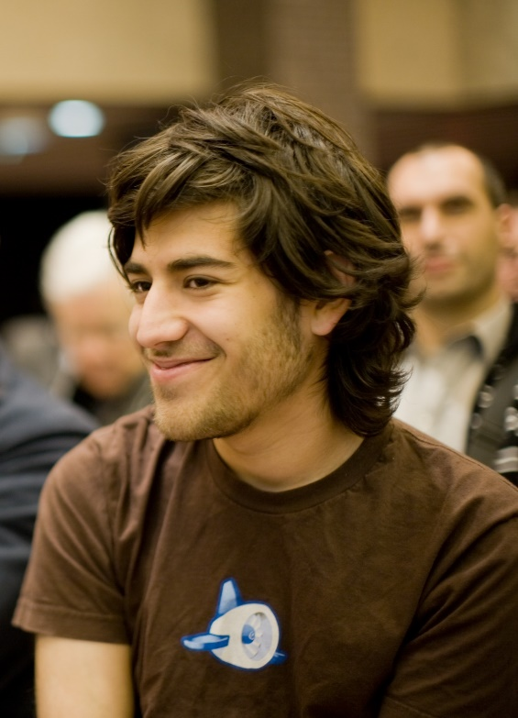
United States v. Swartz
U.S. District Court for Massachusetts, 945 F. Supp. 2d 216 (2013)
Defendant: Aaron Swartz
Computer programmer, writer, political organizer, Internet activist, co-founder of Reddit, etc.
Charges: Multiple violations of the Computer Fraud and Abuse Act (CFAA) for downloading academic journal articles from JSTOR via MIT's network
https://en.wikipedia.org/wiki/Aaron_Swartz

Slide 5
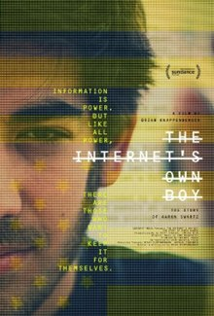
United States v. Swartz
Tragically, Aaron Swartz died by suicide in January 2013.
The case was dismissed.
Sparked public debates on internet freedom, legal reform, copyright, and the ethics of prosecuting cybercrimes.
Swartz was a research fellow at Harvard who connected a laptop to a networking switch in an unlocked controlled-access wiring closet at MIT.
MIT has an “open campus” where visitors have access to JSTOR.
Swartz downloaded a large amount of the JSTOR database.
Swartz was arrested near Harvard on 1/6/2011.
Indicted on 7/11/2011 on four felony counts, faced up to 35 years in prison and $1M in fines.
https://en.wikipedia.org/wiki/The_Internet%27s_Own_Boy

Slide 6
Remedies
Equitable Relief

Slide 7
Injunctions – 17 USC Section 502
(a) Any court having jurisdiction of a civil action arising under this title may, subject to the provisions of section 1498 of title 28, grant temporary and final injunctions on such terms as it may deem reasonable to prevent or restrain infringement of a copyright.
(b) Any such injunction may be served anywhere in the United States on the person enjoined; it shall be operative throughout the United States and shall be enforceable, by proceedings in contempt or otherwise, by any United States court having jurisdiction of that person. The clerk of the court granting the injunction shall, when requested by any other court in which enforcement of the injunction is sought, transmit promptly to the other court a certified copy of all the papers in the case on file in such clerk’s office.

Slide 8
Permanent & Preliminary Injunctions
Permanent
  Typically issued at the conclusion of a copyright infringement suit
Preliminary
  Issued before the conclusion of a suit when it becomes apparent that the defendant will likely lose and that allowing the defendant’s behavior to continue in the meantime would cause the plaintiff serious harm

Slide 9
Permanent or Preliminary?
To obtain a permanent injunction, plaintiff must show
(a) the plaintiff has suffered an irreparable injury;
(b) monetary damages are inadequate to compensate for that injury;
(c) the balance of hardships favors the plaintiff; and
(d) the public interest would not be disserved by a permanent injunction.
To obtain a preliminary injunction, plaintiff must show
(a) the plaintiff is likely to suffer an irreparable injury;
(b) monetary damages will be inadequate to compensate for that injury;
(c) the balance of hardships favors the plaintiff;
(d) the public interest would not be disserved by an injunction; and
(e) likelihood of success on the merits.

Slide 10
Cases Where Injunctions Were Granted
Warner Bros, Inc. v. RDR Books (2008)
Universal City Studios v. FilmOn.com Inc. (2012)
Capitol records, LLC v. ReDigi Inc. (2013)
Disney Enterprises, Inc. v. VidAngel, Inc. (2016)

Slide 11
Cases Where Injunctions NOT Granted
Stewart v. Abend (1988)
Campbell v. Acuff-Rose Music, Inc. (1994)
New York Times, Inc. v. Tasini (2001)

Slide 12
Injunctions Today
Previously, injunctions were common
eBay v. MercExchange (SCOTUS, 2006)
Injunctions in copyright cases should be governed by same principles as injunctions in patent cases
Result: More difficult to obtain an injunction today

Slide 13
Remedies
Damages

Slide 14
Damages: Three Types
Actual damages
Recover profits made by defendants attributable to the defendant’s infringing behavior
Statutory damages

Slide 15
Actual Damages
Profits the plaintiff would have earned had the defendant not infringed unlawfully
Recoup losses sustained if forced to reduce the price of authorized copies to compete with infringing defendant
Recover from defendant an amount of money equivalent to the license fee that defendant would have paid to plaintiff to obtain permission
Recover money to compensate for indirect or collateral injuries

Slide 16
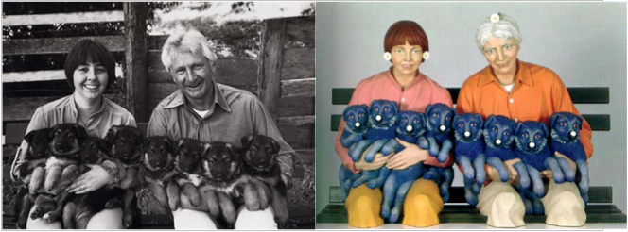
Rogers v. Koons (1992)
https://en.wikipedia.org/wiki/Rogers_v._Koons

Slide 17
Statutory Damages
Section 504c(1)
Except as provided by clause (2) of this subsection, the copyright owner may elect, at any time before final judgment is rendered, to recover, instead of actual damages and profits, an award of statutory damages for all infringements involved in the action, with respect to any one work, for which any one infringer is liable individually, or for which any two or more infringers are liable jointly and severally, in a sum of not less than $750 or more than $30,000 as the court considers just. For the purposes of this subsection, all the parts of a compilation or derivative work constitute one work.

Slide 18
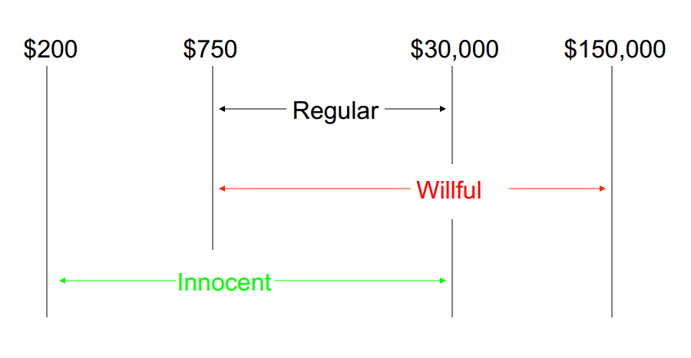
Statutory Damages

Slide 19
Additional Damages
Sometimes plaintiffs who prevail can recover court costs and attorney’s fees
At the discretion of trial court
More commonly awarded in copyright cases than in most other types of lawsuit in the U.S.

Slide 20
Purposes Behind Damages in Copyright Cases
Compensation
Avoid unjust enrichment
Deterrence
Punishment
Maintain the balance between private rights and public interest

Slide 21
Remedies
Criminal Penalties

Slide 22
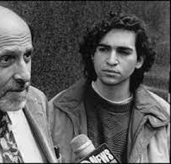
United States v. LaMacchia
Outcome:
Dismissal: December 28, 1994, the court ruled that non-commercial copyright infringement could not be prosecuted under criminal copyright law.
Impact:
LaMacchia Loophole: Highlighted a gap in copyright law, leading to the passage of the NET Act in 1997 to address non-commercial copyright infringement.
Defendant: David LaMacchia
21-year-old MIT student
LaMacchia created an online bulletin board, Cynosure, to distribute copyrighted software without authorization
Charges: Indicted for wire fraud
Wire fraud is a federal crime involving the use of electronic communications (phone, internet, etc.) to deceive and gain money or property, often across state lines.
http://tech.mit.edu/V114/N68/lamacchia.00n.html

Slide 23
The Growth of Criminal Copyright
1997: No Electronic Theft Act
allows for criminal prosecution of copyright infringement even when there is no monetary profit or commercial benefit
1998: Digital Millennium Copyright Act (DMCA)
implements two World Intellectual Property Organization (WIPO) treaties and criminalizes the circumvention of digital rights management (DRM) technologie
2004: Anti-Counterfeiting Amendments Act
expands criminal provisions to combat trafficking in counterfeit intellectual property products, including labels and packaging

Slide 24
The Growth of Criminal Copyright
2005: Family Entertainment and Copyright Act
Includes provisions to prevent unauthorized recording of motion pictures in theaters and enhances penalties for copyright infringement
2008: Pro-IP Act
Increases civil and criminal penalties for intellectual property infringement and establishes the Office of the United States Intellectual Property Enforcement Representative
2011: Anti-Counterfeiting Trade Agreement (ACTA)
This multilateral treaty aims to establish international standards for intellectual property rights enforcement, targeting counterfeit goods and copyright infringement on the internet

Slide 25
Two Lessons about Criminal Sanctions
Criminal sanctions are both formidable and dangerous
The copyright system as a whole is an extraordinarily complex and powerful machine

Slide 26
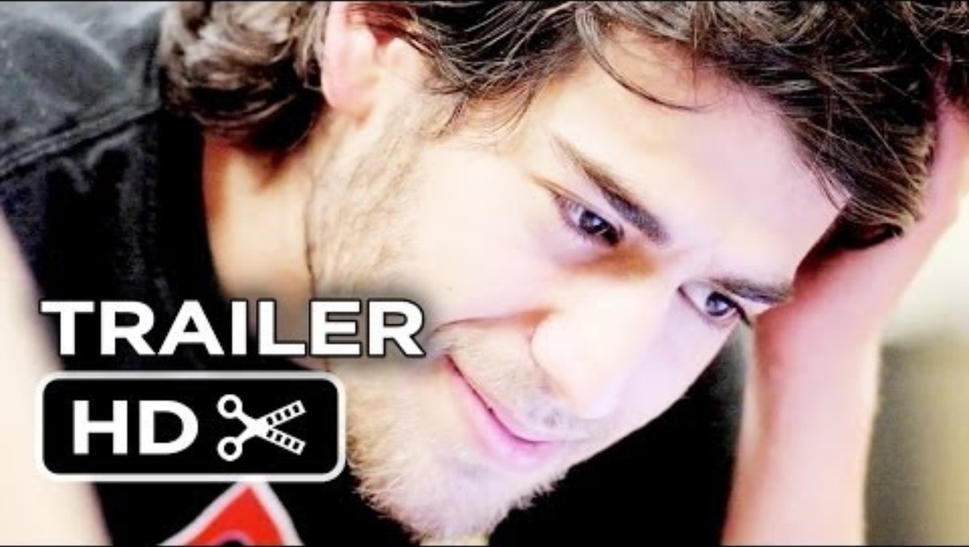

Slide 27
Questions?
Have a great week!

